Slide 1
The influence of metric proficiency on scientific literacy and acceptance of science
Alannah Mack¹, Anique Thompson¹, Kasha Price¹, Kofi Khamit-Kush² , Hong Qin¹
¹ Biology Department, Spelman College ² Psychology Department, Morehouse College, Atlanta, GA 30314, U.S.A.

Slide 2
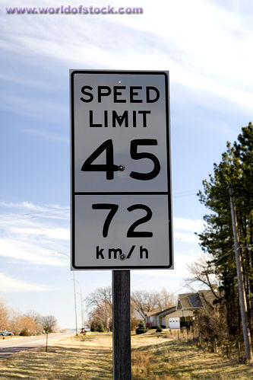
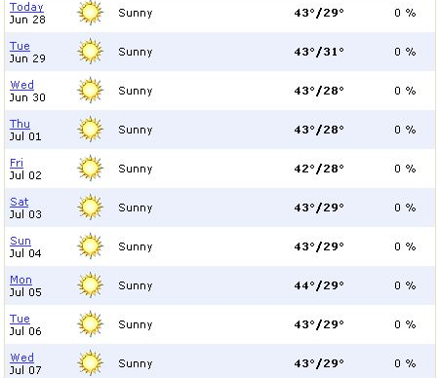
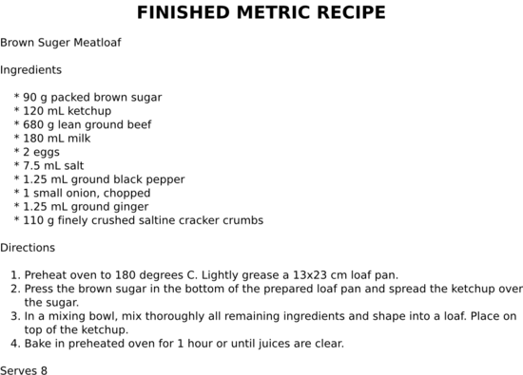

Slide 3
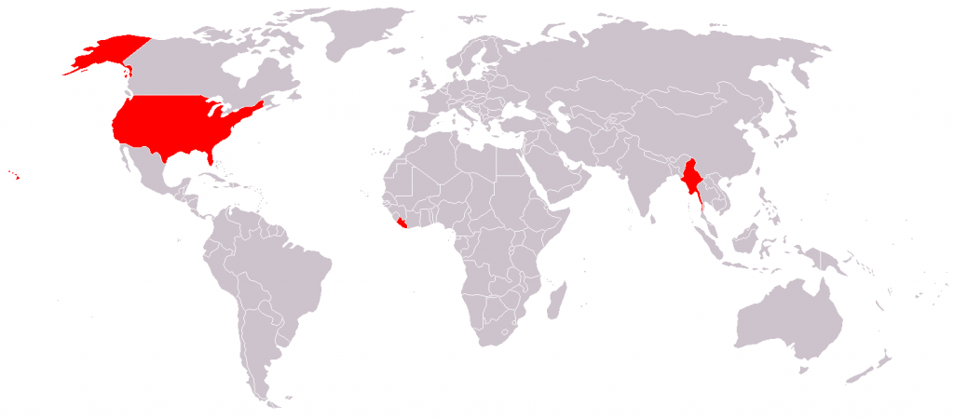
Background
The U.S. is one of three countries that does not employ the metric system.
As a result, Americans often have trouble understanding and relating the metric system to everyday life and experiences.
The metric system is the primary system of measurement in science.

Slide 4
Hypothesis
Does this partition of daily life and scientific understanding hinder the scientific literacy for the American population and impose a negative connotation on science as a whole?
Does one’s understanding of the metric system have an influence on her attitude towards and understanding of scientific concepts?

Slide 5
Methods
We designed a survey to gauge people’s scientific literacy and acceptance of scientific findings based on European survey.
The survey contains 3 sets of problems:
Proficiency of the metric system
Scientific literacy
Attitude and acceptance toward science

Slide 6
A man is 2.16 m tall. Is this person suited to be a good basketball player?

Slide 7
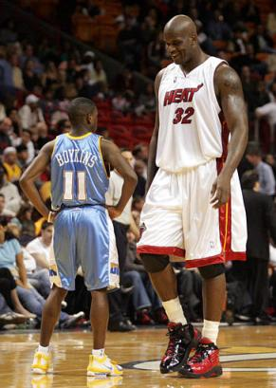

Slide 8
True or False, the continents have been moving their location for millions of years and will continue to move.

Slide 9
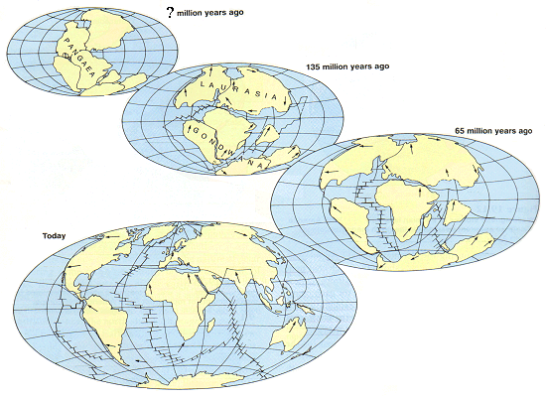

Slide 10
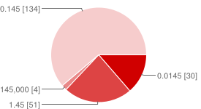
145mm = ___m
Results
Answer | Responses | Percentage
0.145 | 134 | 61%
1.45 | 30 | 23%
0.0145 | 51 | 14%
145,000 | 4 | 2%

Slide 11
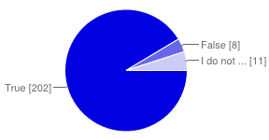
The center of the Earth is very hot.
Answer | Responses | Percentage
True | 202 | 91%
False | 8 | 5%
I don’t know. | 11 | 4%

Slide 12
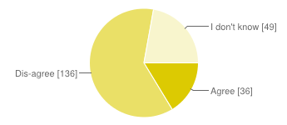
Do you agree that organic food should be DNA-free food?
Answer | Responses | Percentage
Agree | 36 | 16%
Dis-agree | 136 | 62%
I don’t know. | 49 | 22%

Slide 13
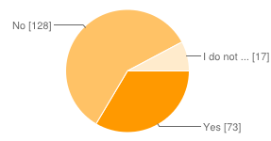
My religious views are more important than scientific views.
Answer | Responses | Percentage
Yes | 73 | 33%
No | 128 | 59%
I don’t know. | 17 | 8%

Slide 14
Analysis
Survey data was quantified.
Used linear regression to model trend relationship between scientific literacy and metric proficiency.
Correct Answer | 1
I don’t know | 0.5
Incorrect Answer | 0

Slide 15
Relationship between metric proficiency and scientific literacy

Slide 16
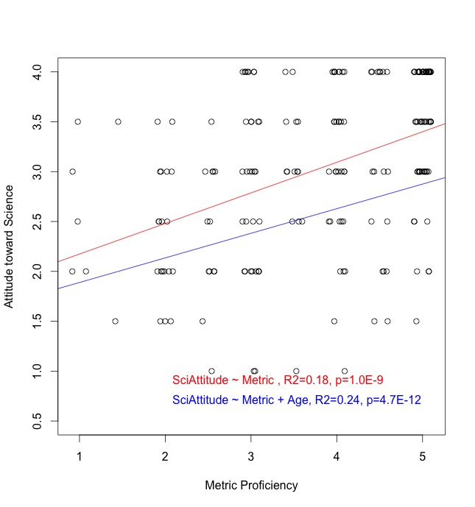
Relationship between metric proficiency and attitude towards science

Slide 17
Conclusion
Metric Proficiency
Scientific Literacy
Attitude toward Science

Slide 18
References
Champagne, A. Newell, S. Directions for research and development: alternative methods of assessing scientific literacy. Journal of Research in Science Teaching, 29 (8), 1992.
Impey, C., Buxner, S., Antonellis, J. Johnson, E., King, C., A twenty-year survey of science literacy among college undergraduates. Journal of College Science Teaching, 40 (4), 2011.
Delgado, Cesar. Units of length: a notational system for conceptual understanding of size and scale. Proceedings of the 9th International Conference of the Learning Sciences. 2010.
Evans, G. Durant, J. The relationship between knowledge and attitudes in the public understanding of science in Britain. Public Understanding of Science, 4 (1). 1995.

Slide 19
Sources of Figures
http://chanadbahraini.blogspot.com/2004_06_01_archive.html
http://www.wikihow.com/Convert-Your-Recipe-to-Metric-and-Use-Weights-Instead-of-Volume

